Slide 1
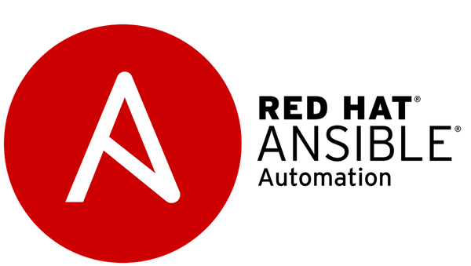

Ansible Automation
Introduction to Redhat automation tool
Khalil Ahmadi - 2022

Slide 2
Plan
What is Ansible?
Ansible Project
Ansible Engine
Ansible Tower/AWX
Where can I use it?
Unix/Linux
Windows
How does it work?
Playbook
Inventory
Modules
Plugins
API
Using Ansible
Install / Update / Remove
Configure
Backup / Restore
POC
Architecture
Backup/Restore
Install/Remove
IBM i
Network

Slide 3
Plan
What is Ansible?
Ansible Project
Ansible Engine
Ansible Tower/AWX
Where can I use it?
Unix/Linux
Windows
How does it work?
Playbook
Inventory
Modules
Plugins
API
Using Ansible
Install / Update / Remove
Configure
Backup / Restore
POC
Architecture
Backup/Restore
Install/Remove
IBM i
Network

Slide 4
What is ansible?
WHAT IS ANSIBLE?
The Ansible project is an open source community sponsored by RedHat. It’s also a simple automation language that perfectly describes IT application environments in Ansible Playbooks.
Ansible Engine is a supported product built from the Ansible community project.
Ansible Tower (Ansible Automation Platform) is an enterprise framework for controlling, securing, managing and extending your Ansible automation engine with a UI and RESTful API.
Ansible AWX is the open source community edition of Ansible Tower .

Slide 5
What is ansible?
SIMPLE | POWERFUL | AGENTLESS
Human readable automation No special coding skills needed Tasks executed in order Usable by every team Get productive quickly | App deployment Configuration management Workflow orchestration Network automation Orchestrate the app lifecycle | Agentless architecture Uses OpenSSH & WinRM No agents to exploit or update Get started immediately More efficient & more secure

Slide 6
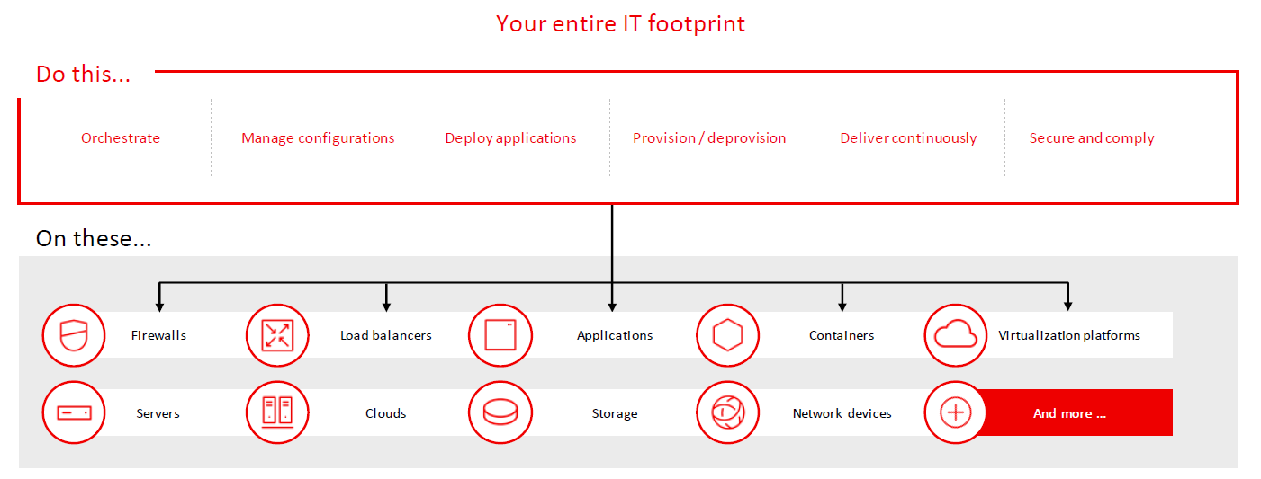
Where can I use it?

Slide 7
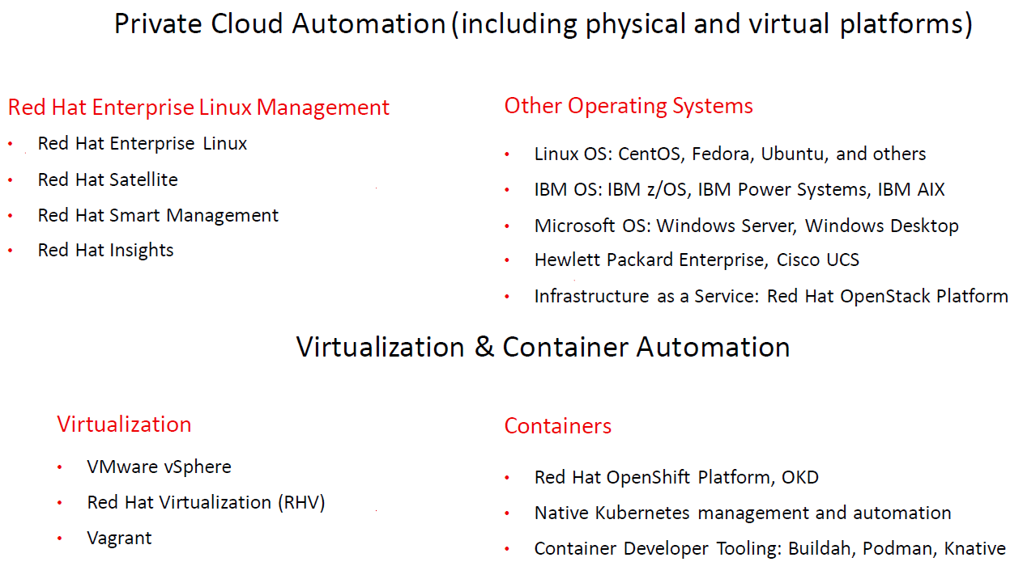
Where can I use it?

Slide 8
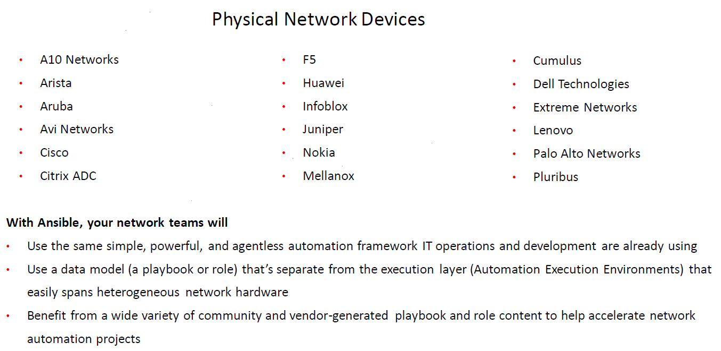
Where can I use it?

Slide 9
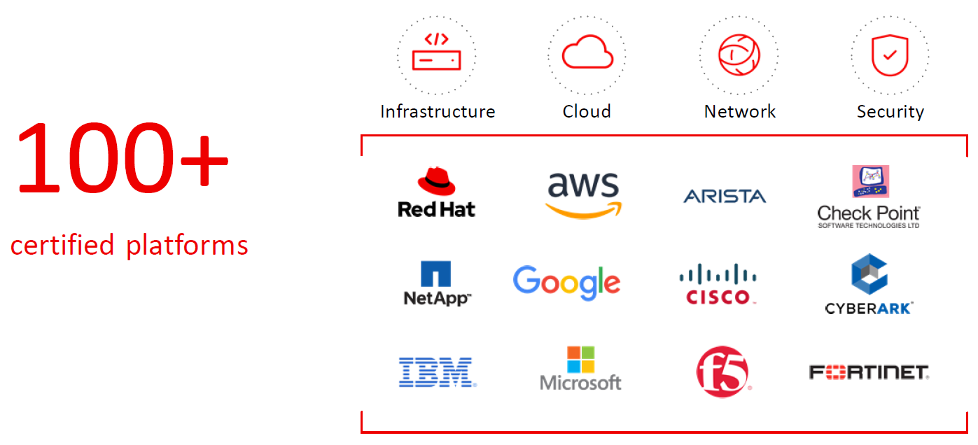
Where can I use it?

Slide 10
Where can I use it?
With Ansible you can automate
CROSS PLATFORM – Linux, Windows, UNIX, IBM i
Agentless support for all major OS variants, physical, virtual, cloud and network
HUMAN READABLE – YAML
Perfectly describe and document every aspect of your application environment
PERFECT DESCRIPTION OF APPLICATION
Every change can be made by playbooks, ensuring everyone is on the same page
VERSION CONTROLLED
Playbooks are plain-text. Treat them like code in your existing version control.
DYNAMIC INVENTORIES
Capture all the servers 100% of the time, regardless of infrastructure, location, etc.
ORCHESTRATION THAT PLAYS WELL WITH OTHERS – HP SA, Puppet, Jenkins, RHNSS, etc.
Homogenize existing environments by leveraging current toolsets and update mechanisms.

Slide 11
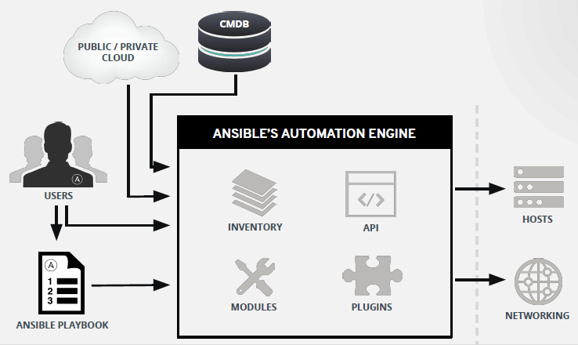
How does it work?

Slide 12
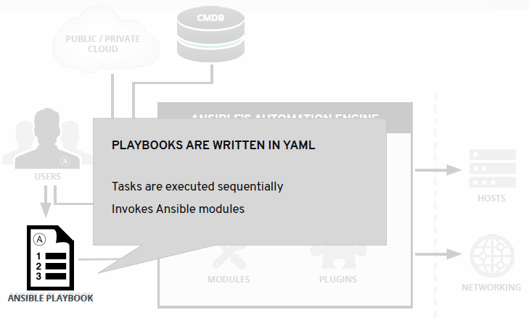
How does it work?

Slide 13
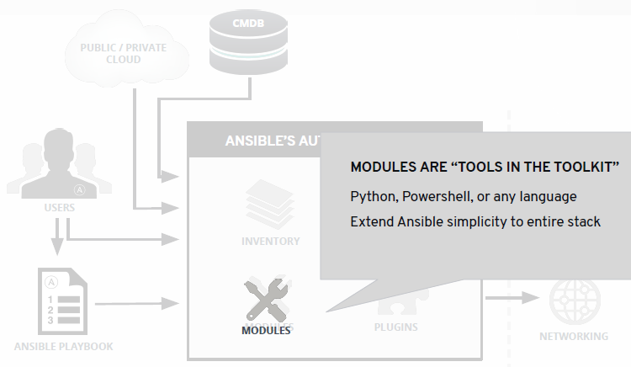
How does it work?

Slide 14
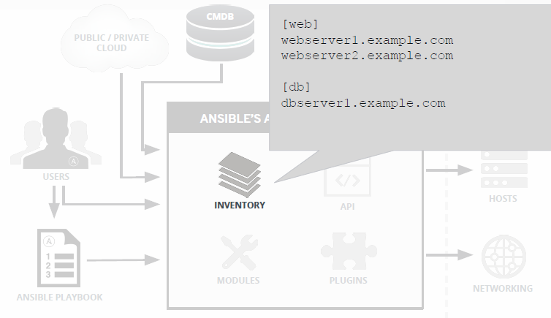
How does it work?

Slide 15
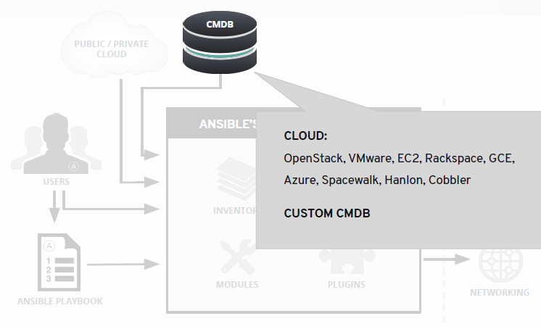
How does it work?

Slide 16
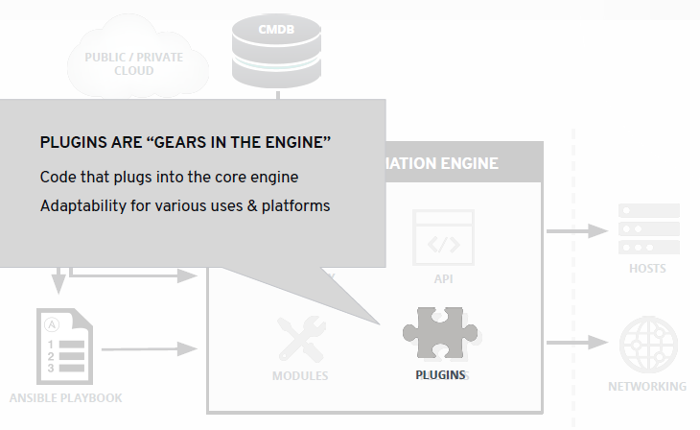
How does it work?

Slide 17
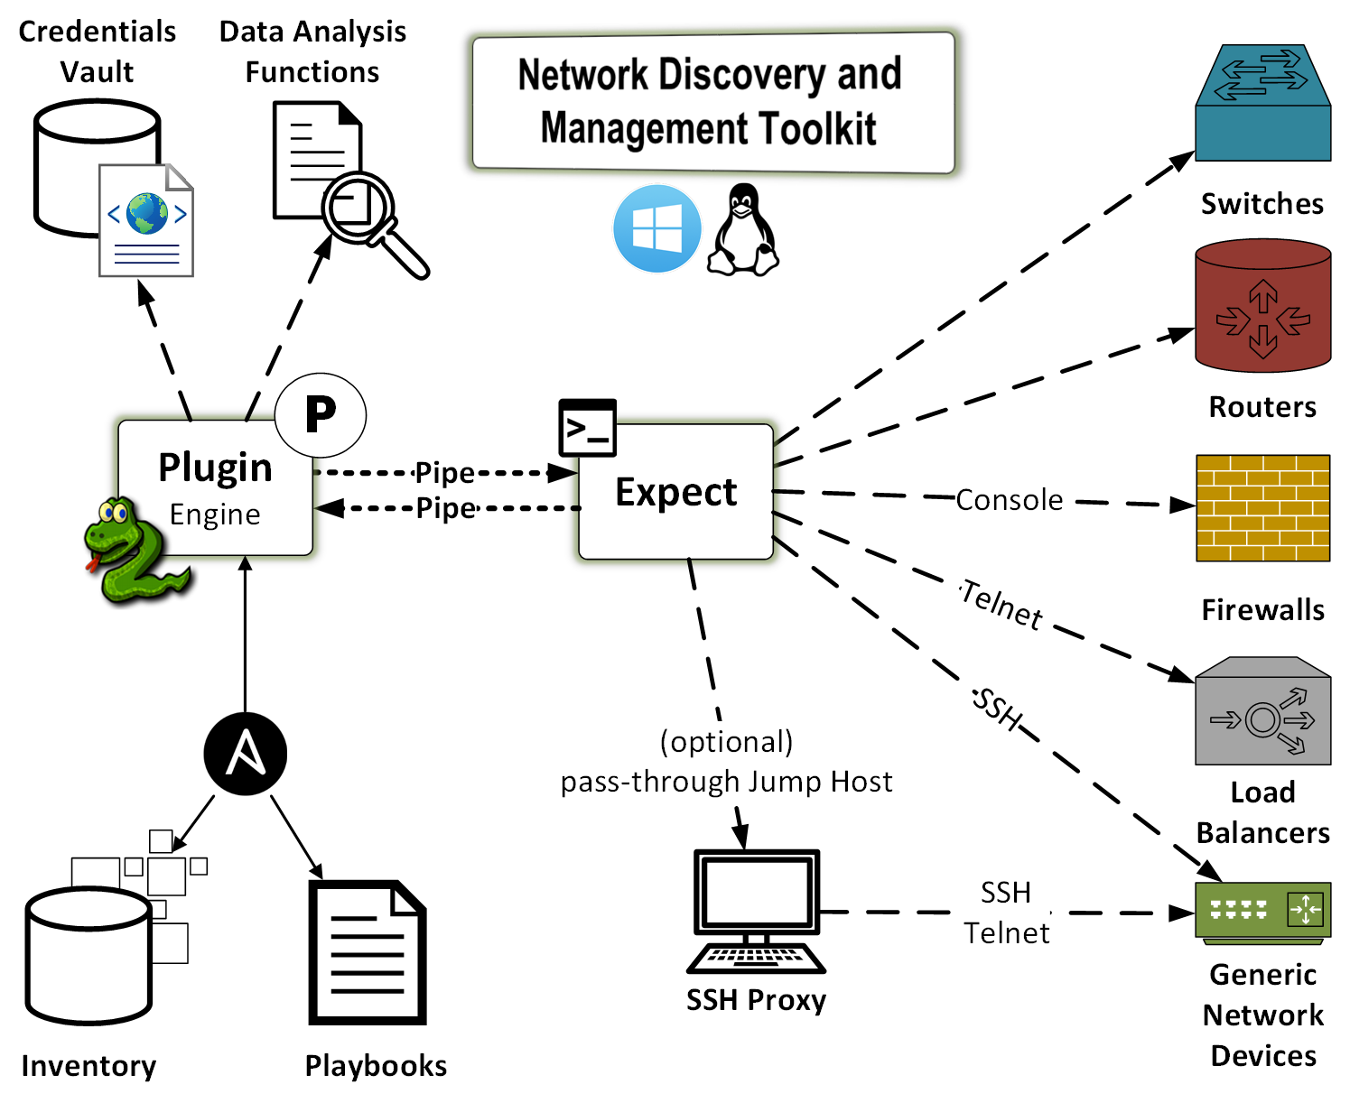
Using Ansible

Slide 18
Using Ansible
Ad-hoc commands
# check all my inventory hosts are ready to be managed by Ansible
$ ansible all -m ping
# run the uptime command on all hosts in the web group
$ ansible web -m command -a “uptime”

Slide 19
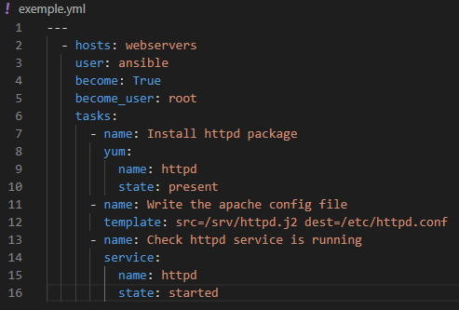
Using Ansible
Playbook

Slide 20
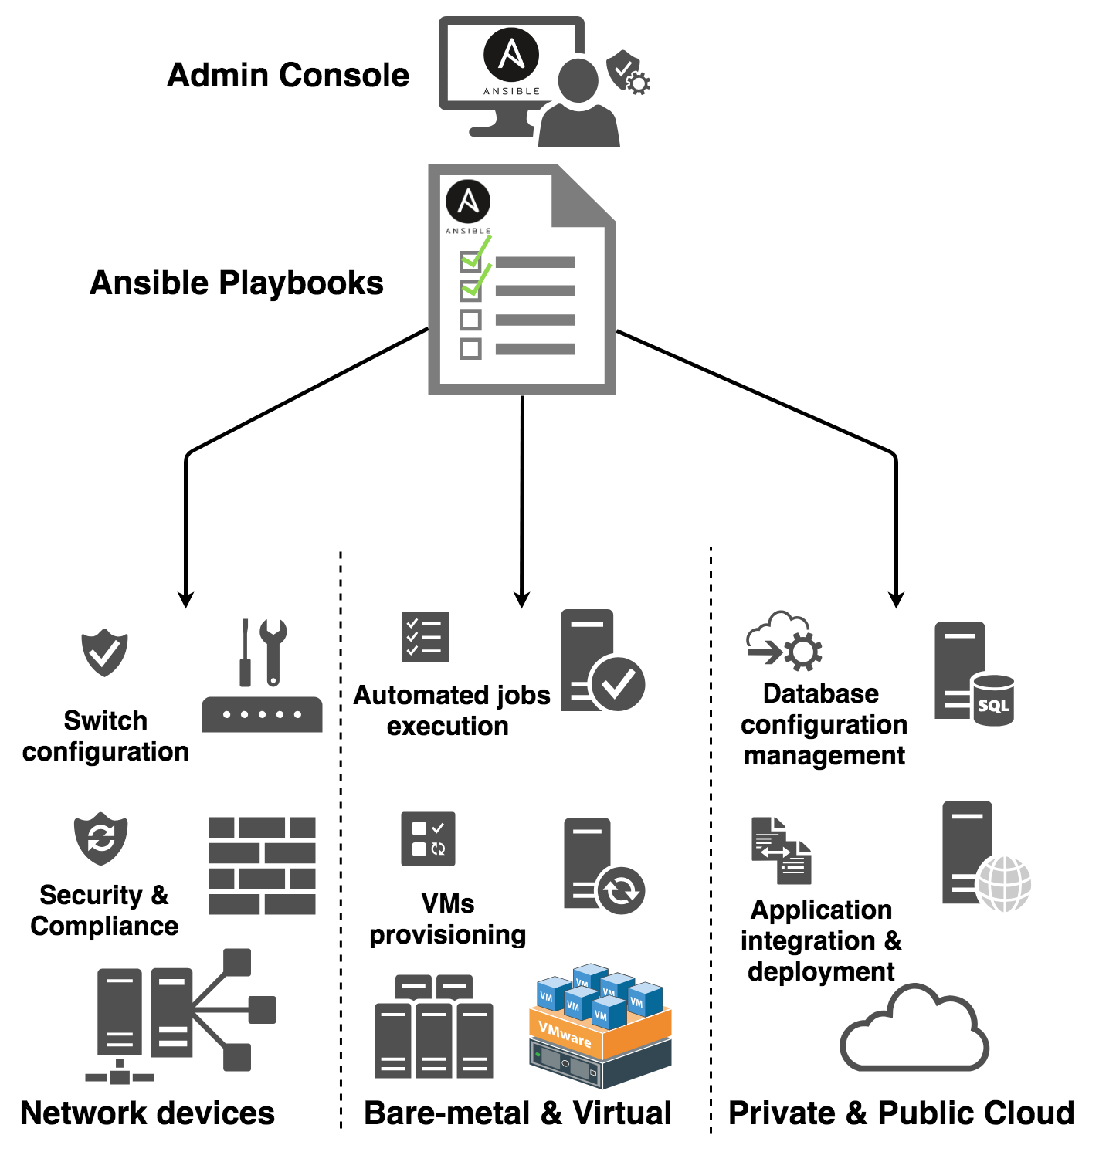
Using Ansible

Slide 21
Using Ansible
Inventory
An inventory is a file containing:
• Hosts
• Groups
• Inventory-specific data (variables)
• Static or dynamic sources

Slide 22
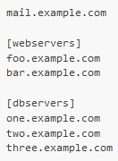
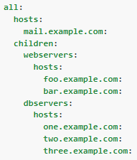


Using Ansible
Basic Inventory YAML Inventory

Slide 23
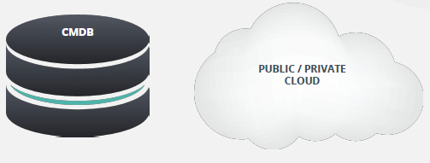
Using Ansible
Dynamic Inventories
● Stay in sync automatically
● Reduce human error

Slide 24
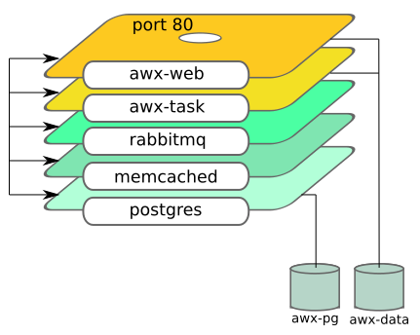
POC
AWX Architecture

Slide 25


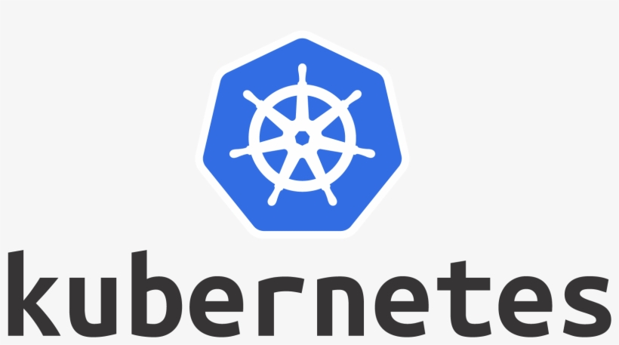
POC
Architecture
GitHub
HTTPS/SSH
HTTPS
Administrator
Ansible AWX
Operator
Web1
SSH
SSH
Devops1
atb
db
restoredb
atb
db
restoredb

Slide 26
POC
DEMO : http://awx:30080/login

Slide 27
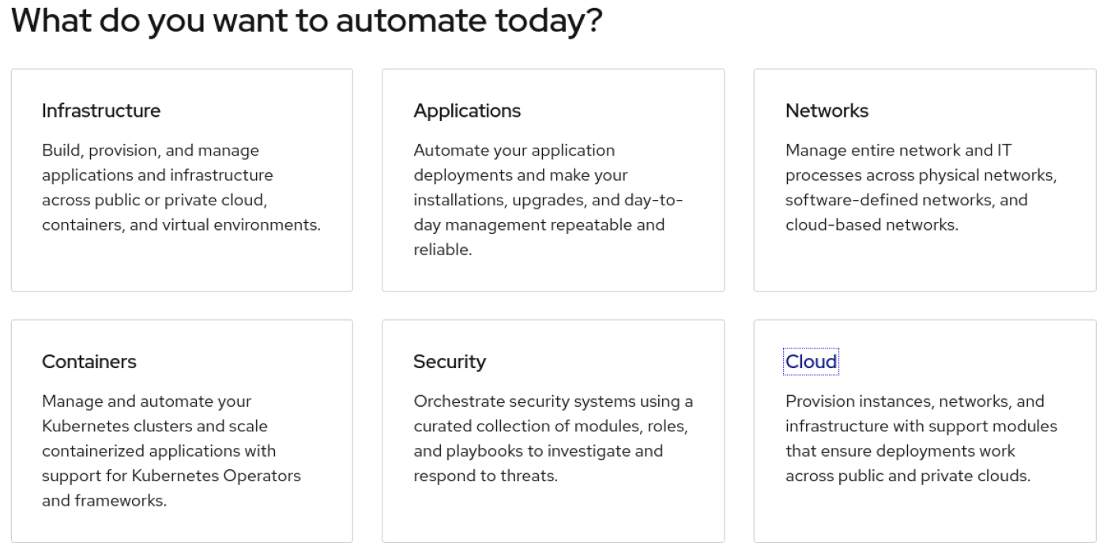
Thank you !

